Slide 1
NAVIGATION
Bring your map and be prepared to ask for directions!

Slide 2
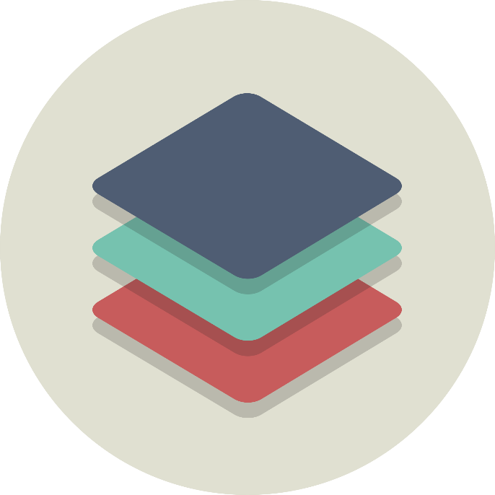

The Navigation Stack
Ionic is creating a stack of pages as we move around the app
Newly opened pages get pushed onto the stack
When we hit the back button, the last page is popped off the stack
Ionic does support more than one stack

Slide 3

Creating an app skeleton
We can now build a ‘skeleton’ app so we can see how we will navigate around. First of all we need some pages.
Ionic generate page [name] –no-module
We do this for each page we want to create in our application and add tell Ionic that they are there. Finally we’ll put some links in…

Slide 4
Using The Navigation Stack
We add and remove items to and from the navigation stack with the help of the NavController.
This is pre-imported into pages generated in Ionic using the CLI.
We create our own instance of the NavController and push the page we want to navigate to onto the stack, like so…
We already have a back button that returns us to the home page. To mimic this behaviour we can pop the current page off the stack like how we pushed the page onto the stack

Slide 5
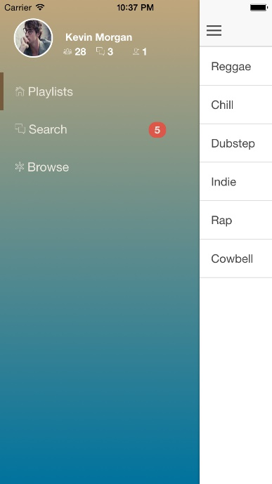
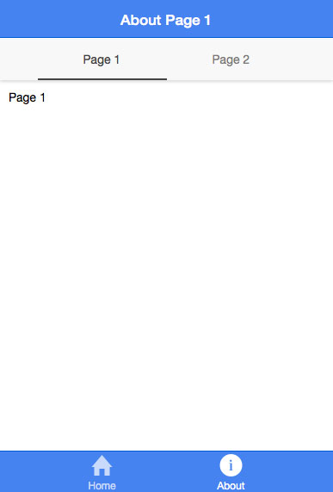
Navigation Types
Two types of navigation in Ionic
Side Menu $ ionic start myApp sidemenu
Tabs $ ionic start myApp tabs
For usability reasons it’s best to choose just one
Which one is right for your app?

Slide 6
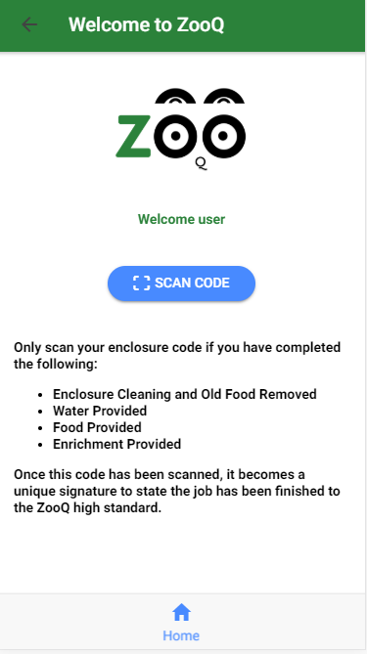
Navigation Types Tabs
Tabs give the user a very familiar user experience first adopted by Apple iPhone
The example to the right simply use’s the device camera to read a code
We want this app to feel like an extension or feature of the device

Slide 7
CHALLENGE TIME!
Build a side menu navigation that links to all of the pages you have created
For bonus points, expand your application:
Create a new page
Declare this page in the app config
Link to it from your menu

Slide 8
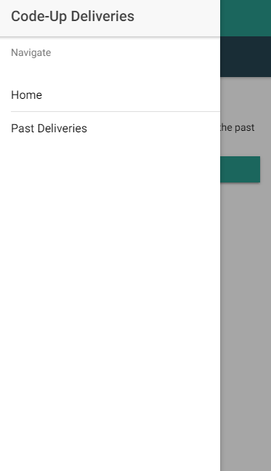
Navigation For Our Delivery App
We have a lot of pages to navigate with our Delivery App, so we put our links in a side menu
We can customise our menu
Let’s take a look at how we’d do this in our app…

